Slide 1
Project Proposal
The State of Florida is one of the nation’s fastest growing states, with 1,000 people moving here every day.
People are attracted to the great quality of life and its pro-business environment.
The problem is that it is very difficult to find clear answers and a clear guide on how to open a business in Florida.
Our proposed solution will provide clear answers to the typical questions that are asked when someone is starting a business.
How do I register my business with the State of Florida?
What structure should I use: Limited Liability Corporation, Sole Proprietorship, Partnership, Corporation, etc.
What permits and licenses are required?
We will create a helpful assistant or Chatbot that will respond to inquiries in a friendly manner.

Slide 2

Data Collection
Collection
Government/Federal government websites.
Business structure | Fees | Minimal Wages | Market Research
PromptsDataSet.slsx
Stores the set of prompts for the AI Model.
Prompts will give context to the AI.
Additional Data
State Licenses
Federal Licenses
Business Classification Structure
Miami Dade County database for Local Business Tax & Fees
Miami-Dade Zip codes & Municipalities
Employee estimate for wages
Census bureau establishments by county and zip code

Slide 3
Data Preparation
Data preparation step does not apply in the traditional sense.
No need to find missing or duplicated values.
Data was extracted in the data collection phase from various websites/datasets and compiled into text files.
The text files contained question & answer paragraphs with the purpose of guiding the LLM.

Slide 4
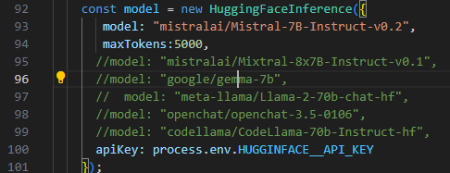
Modeling
Large Language Models (LLMs)
Needs to be open source.
We don’t want to deal with tokens.
We don’t want to deal with hosting, equipment, or allocation of the model.
Model & Testing phase
Hugging Face: mistralai/Mistral-7B-Instruct-v0.2 · Hugging Face
Didn't hallucinate answers.
Good at looking at the context and answering within context.
Speed of response was optimal.

Slide 5
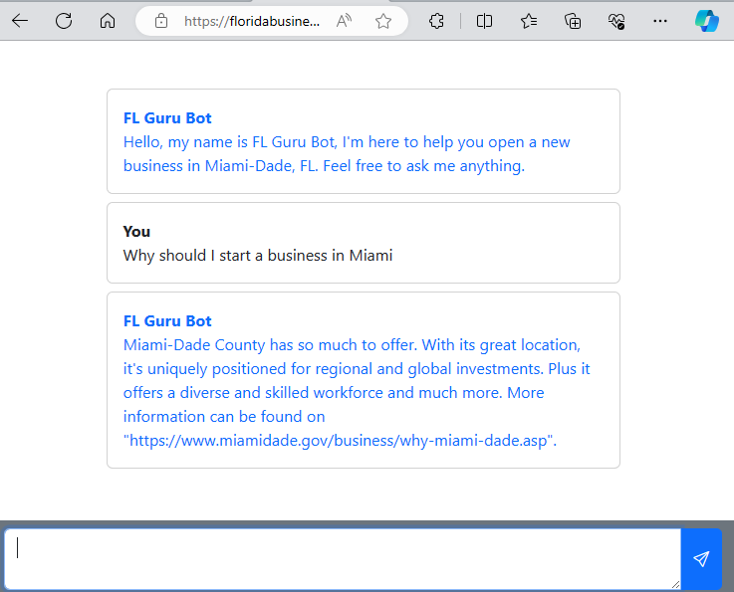


Production
Context Text. Found on file context.txt
Answer from the Chatbot
When asked on why to start a business in Miami, answer with: Miami-Dade County has so much to offer. With its great location, it's uniquely positioned for regional and global investments. Plus, it offers a diverse and skilled workforce and much more. More information can be found on https://www.miamidade.gov/business/why-miami-dade.asp
Site Link
floridabusinessguru.netlify.app

Slide 6
Model Output
LLM Model Observations
Our model answers correctly as long as the question is present in the context.
Sometimes the model may take 3 seconds to answer due to the Hugging Face server getting too many requests.
Possible solution: Upgrading to a paid tier with more dedicated resources.
Context Optimization
The context file may get very big. Thousands of possible questions and answers. Making the model slow and inaccurate.
Solution: We implemented a technique called Retrieval Augmentation Generation (RAG). Only a subset of the context that is most relevant to the question will be passed to the LLM model.
RAG may impact the performance. Consider upgrading to a paid tier with more dedicated resources.

